Slide 1
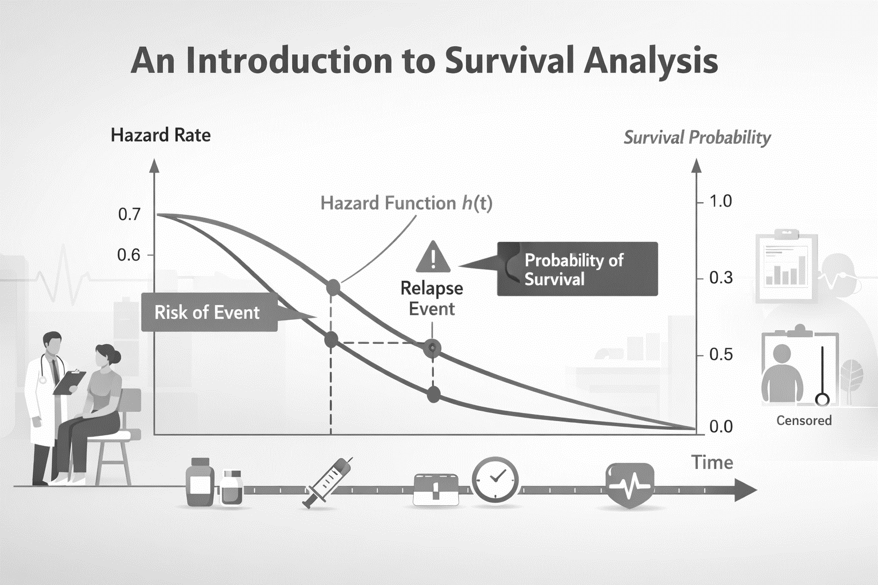
INTRODUCTION TO SURVIVAL ANALYSIS

Slide 2
Introduction
So far we have looked at how to model data when an outcome is;
Continuous (linear regression)
Binary (logistic regression)
Count outcome (Poisson regression)
Sometimes, we are not only interested in the occurrence of an outcome, but also in the time interval from a defined starting point to when that outcome happens, because timing can affect prognosis, risk, and intervention effectiveness.
Sometimes, we do not witness the outcome of interest.
To analyse data that measures how much time passed before the outcome of interest occurred, we use survival analysis techniques

Slide 3
Introduction
‘Survival Analysis’ refers to techniques dealing with ‘time to an event’ data :
Survival analysis examines time until an event occurs.
E.g.
time to death;
time to recovery or cure;
waiting time for surgery;
Time to mechanical failure;
Time to remission
‘Time to event’ variables are commonly used endpoints in clinical studies, including RCTs and longitudinal cohort studies.

Slide 4
Introduction
Survival analysis is used to analyse data in which the time until the event of interest occurs.
The ‘response variable’ is often referred to as a failure time, survival time, or event time.
Failure times are always non-negative. That is, if we denote the failure time random variable by T, then T ≥0.
T can either be discrete or continuous
In order to define a failure time random variable, we need:
A time origin t(0) (e.g. diagnosis of a disease, start of treatment, servicing of a car, etc.,
A time scale (e.g. days, years, mileage of a car)
Definition of the ‘event’ (e.g. death, remission of cancer, car breakdown, vaccination)

Slide 5
Introduction
When dealing with ‘time to an event’ data, two issues present a challenge for analysis : (i) The distribution of ‘time to event’ variables is very often right skewed.
While some individuals will experience the event of interest soon after t(0), others will experience the event much later
In a group of patients who undergo chemotherapy for breast cancer and achieve remission, the length of time each individual remains in remission will vary

Slide 6
Introduction
(ii) Time to event data is often ‘censored’.
Censoring refers to incomplete measurement of the time to an event or not observing the event of interest.
While most study participants will experience the event of interest during the study, others will not, or will be lost to follow up.
In our example of women who undergo chemotherapy for breast cancer and achieve remission, some women will relapse during the study period while others will remain in remission till the end of the study period

Slide 7
Left vs Right Censoring
Let us imagine that some proportion of the population has been exposed to a virus and individuals are tested at a given point in time to see whether they have the virus or not.
We will assume that these tests are very accurate
Given this assumption, we can say that people with a positive test contracted the virus at some point leading up to the test, but we don’t know exactly when they contracted the virus.
We do not know how much time passed between exposure and infection
These are ‘left censored’

Slide 8
Left vs Right Censoring
They are left-censored, since the event is when the individual contracted the virus, not the positive test.
Left censoring is when the event has occurred before the data is collected (or study has started) – that is we only know the upper bound of the time.
The same test is repeated at time(t) among the non-infected participants. Participants who test positive are said to be interval censored.
Interval censoring occurs when the event of interest occurs during a known time window

Slide 9
Left vs Right Censoring
A final test is done among the remaining exposed participants
All individuals who test negative will be said to be right censored
All individuals who contracted the virus after the last testing and all individuals who never contracted the virus are considered to be ‘right censored’.
Right censoring occurs when a participant has not yet reached the milestone of interest at the end of the study
Subjects with a censored time are known to have been in uninfected for at least that time – but the actual time is unknown presenting an issue for analysis.

Slide 10
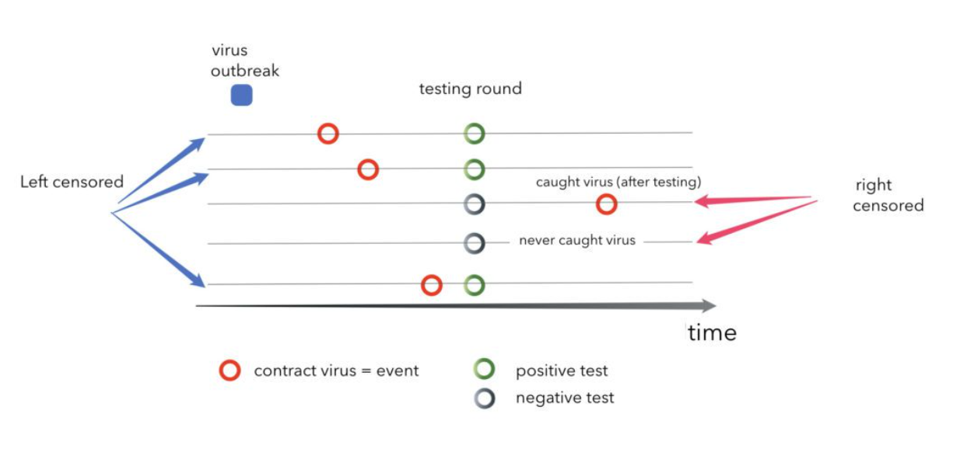
Left vs Right Censoring
In this rather unique case, our dataset is filled with only left and right censored cases, we actually never observe the event directly and only have lower and upper bounds for individuals’ time of contracting the virus
The study ends at the testing round

Slide 11
Censoring
There are generally three reasons why right- censoring might occur:
A subject does not experience the event before the study ends
A person is lost to follow-up during the study period
A person withdraws from the study
*These are all examples of right-censoring.

Slide 12
Censoring
Example: Cancer patients in remission were recruited in a study to observe how long they would remain in remission
Subject Recruited Week 4
End of Remission Week 28
Right Censoring
?
Subject Recruited Week 25
End of Remission ???
Right Censoring
?
Subject Recruited Week 7
Drops out of Study Week 34
End of Remission ???
Start of Recruitment
Week 0
End of Study
Week 52

Slide 13
Non-informative and Informative Censoring
Censoring can also be categorized based on the relation between censoring times and survival times
Censoring is considered to be noninformative if the reason an observation is censored (i.e., we don’t observe the event for that subject) is statistically independent of the likelihood or timing of the event itself
If a patient drops out of a study because they moved to another city, and this move is unrelated to their health status, the censoring is non-informative
In a cancer trial, if patients receiving a toxic treatment drop out early due to side effects, and those side effects are linked to disease progression, their dropout is informatively censored
If a patient drops out because their condition worsened, and that affects their risk of the event (e.g., death), the censoring is informative, which violates the assumption.

Slide 14
Why standard logistic regression wont work
If there is no censoring and we dichotomise the data, standard regression procedures could be used.
E.g. Remission time < 10 weeks versus > 10 weeks.
However, these may be inadequate because
Time to event is a skewed distribution.
The probability of surviving past a certain point in time may be of more interest than the expected time of event.

Slide 15
Methods for time to event data
Some statistical methods do not assume a ‘normal’ distribution and explicitly deal with censoring
These methods are based on; 1) The Survival function 2) The Hazard function

Slide 16
Survival function
In survival analysis, the survival function, denoted as S(t), gives the probability that an individual or item survives beyond a certain time t
S(t)=P(T>t)
It’s a foundational concept used to understand how long something lasts before an event occurs.
Example;
S(12_{months})₌0.80,
then 80% of individuals are expected to survive beyond 12 months.

Slide 17
The survival Function
As t ranges from 0 to ∞, the survival function has the following properties
It is non-increasing
At time t = 0, S(t) = 1. In other words, the probability of surviving past time 0 is 1.
At time t = ∞, S(t) = S(∞) = 0. As time goes to infinity, the survival curve goes to 0.
In theory, the survival function is smooth. In practice, we observe events on a discrete time scale (days, weeks, etc.).

Slide 18
The Survival Function
The survival function provides the probability of ‘survival’ past a certain time point.

Slide 19
The Survival Function
Survival functions need to be estimated from observed data. Two principal methods of estimation are : (i) Lifetables; (ii) Kaplan-Meier Product Limit method.
Survival between groups can be compared by comparing the survival function.

Slide 20
The Survival Function – Lifetables
The construction of a lifetable is as follows:
Time is split into fixed intervals, e.g. 0 to 3 months, 3 to 6 months, 6 to 9 months etc.
Number of individuals at risk at the beginning of the i^{th} time interval is N_{i}.
The number of individuals dying i.e., experiencing event of interest (not censored) is D_{i}. The probability of surviving i^{th} time interval is p_{i} = 1 - D_{i}/N_{i} [However – this calculation is adjusted for censoring]
The probability of surviving past the n^{th} time interval is p₁ x p₂ x p₃ x ... P_{n} (cumulative probability)

Slide 21
The Survival Function – Lifetables
Interval in years | Number At Risk During Interval, N_{t} | Number of Deaths During Interval, D_{t} | Lost to Follow-Up, C_{t} | Average Number At Risk During Interval, N_{t*} | Proportion Dying During Interval, q_{t} | Among Those at Risk, Proportion Surviving Interval, p_{t} | Survival Probability S_{t}
0-4 | 20 | 2 | 1 | 20-(1/2) = 19.5 | 2/19.5 = 0.103 | 1-0.103 = 0.897 | 1(0.897) = 0.897
5-9 | 17 | 1 | 2 | 17-(2/2) = 16.0 | 1/16 = 0.063 | 1-0.063 = 0.937 | (0.897)(0.937)=0.840
the average number of participants at risk during interval t [In constructing actuarial life tables, the following assumptions are often made: First, the events of interest (e.g., deaths) are assumed to occur at the end of the interval and censored events are assumed to occur uniformly (or evenly) throughout the interval. Therefore, an adjustment is often made to N_{t} to reflect the average number of participants at risk during the interval, N_{t*}, which is computed as follows: Nt* =Nt-Ct/2 (i.e., we subtract half of the censored events).

Slide 22
The Survival Function – Lifetables
Interval in Years | Number At Risk During Interval, N_{t} | Average Number At Risk During Interval, N_{t*} | Number of Deaths During Interval, D_{t} | Lost to Follow-Up, C_{t} | Proportion Dying During Interval, q_{t} | Among Those at Risk, Proportion Surviving Interval, p_{t} | Survival Probability S_{t}
0-4 | 20 | 19.5 | 2 | 1 | 0.103 | 0.897 | 0.897
5-9 | 17 | 16.0 | 1 | 2 | 0.063 | 0.937 | 0.840
10-14 | 14 | 12.0 | 1 | 4 | 0.083 | 0.917 | 0.770
15-19 | 9 | 7.5 | 1 | 3 | 0.133 | 0.867 | 0.668
20-24 | 5 | 3.0 | 1 | 4 | 0.333 | 0.667 | 0.446

Slide 23
The Survival Function – Lifetables
Interval in Years | Survival Probability S_{t}
0-4 | 0.897
5-9 | 0.840
10-14 | 0.770
15-19 | 0.668
20-24 | 0.446

Slide 24
The Survival Function – Lifetables

Slide 25
The Survival Function – Lifetables

Slide 26
The Survival Function – Lifetables
The lifetable approach relies on pre-specified time intervals – different intervals will produce different estimates.
The larger the time intervals considered the more crude the estimates.
However, if the intervals are too fine then few will contain any information.

Slide 27
The Survival Function – Kaplan-Meier Method
An issue with the life table approach shown above is that the survival probabilities can change depending on how the intervals are organized, particularly with small samples.
The Kaplan-Meier approach, also called the product-limit approach, is a popular approach which addresses this issue by re-estimating the survival probability each time an event occurs.

Slide 28
The Survival Function – Kaplan-Meier Method
The Kaplan-Meier Product Limit Method (1958) uses the same approach as the lifetable method. However, the time intervals are defined to include just one event (more when ties are present).
With the actuarial life table approach we consider equally spaced intervals,
While with the Kaplan-Meier approach, we use observed event times and censoring times.
It’s a non-parametric method, meaning it doesn’t assume any specific distribution for survival times.

Slide 29
Kaplan-Meier curve.
Time is plotted on the x-axis and the survival rate is plotted on the y-axis.
The curve is stepwise, dropping at each event time and staying flat between events.
It accounts for censored data, which is crucial in real-world studies.

Slide 30
Kaplan-Meier curve.
The Kaplan Meier curve shows what the probability of an event (for example, survival) is at a certain time interval.
Kaplan-Meier analysis allows you to quickly obtain a population survival curve and essential statistics such as the median survival time.
Kaplan-Meier analysis is used to analyze how a given population evolves with time.

Slide 31
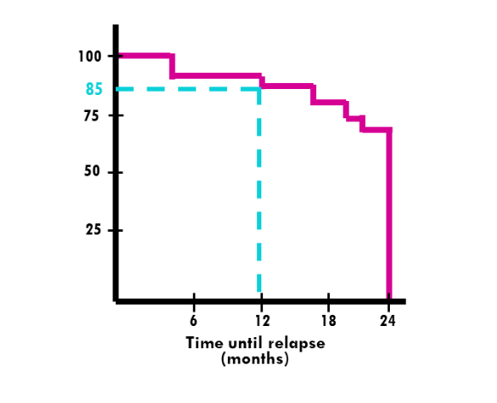
Kaplan-Meier curve
In our breast cancer example, our interest is to see the probability of someone being in remission past a certain time point.
With time plotted on the x-axis. The Kaplan-Meier can graphically show probability of being in remission at 6, 12, 18, 24 months

Slide 32
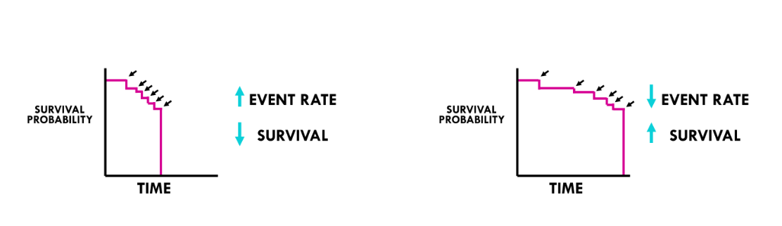
Kaplan-Meier curve
A steeper slope indicates a higher event rate. If the event is death, then it means worse survival
A flatter slope indicates a lower event rate. In other words, a better survival prognosis

Slide 33
The Survival Function – Kaplan-Meier Method
The table below uses the Kaplan-Meier approach to present the same data that was presented above using the life table approach
Note that we start the table with Time=0 and Survival Probability = 1.
At Time=0 (baseline, or the start of the study), all participants are at risk and the survival probability is 1 (or 100%).
With the Kaplan-Meier approach, the survival probability is computed using S_{t+1} = S_{t}*((N_{t+1}-D_{t+1})/N_{t+1}).

Slide 34
The Survival Function – Kaplan-Meier Method
Time, Years | Number at Risk Nt | Number of Deaths Dt | Number Censored Ct | Survival Probability S_{t+1} = S_{t}*((N_{t+1}-D_{t+1})/N_{t+1})
0 | 20 |  |  | 1
1 | 20 | 1 |  | 1*((20-1)/20) = 0.950
2 | 19 |  | 1 | 0.950*((19-0)/19)=0.950
3 | 18 | 1 |  | 0.950*((18-1)/18) = 0.897
5 | 17 | 1 |  | 0.897*((17-1)/17) = 0.844
6 | 16 |  | 1 | 0.844
9 | 15 |  | 1 | 0.844
10 | 14 |  | 1 | 0.844
11 | 13 |  | 1 | 0.844
12 | 12 |  | 1 | 0.844
13 | 11 |  | 1 | 0.844
14 | 10 | 1 |  | 0.760
17 | 9 | 1 | 1 | 0.676
18 | 7 |  | 1 | 0.676
19 | 6 |  | 1 | 0.676
21 | 5 |  | 1 | 0.676
23 | 4 | 1 |  | 0.507
24 | 3 |  | 3 | 0.507

Slide 35
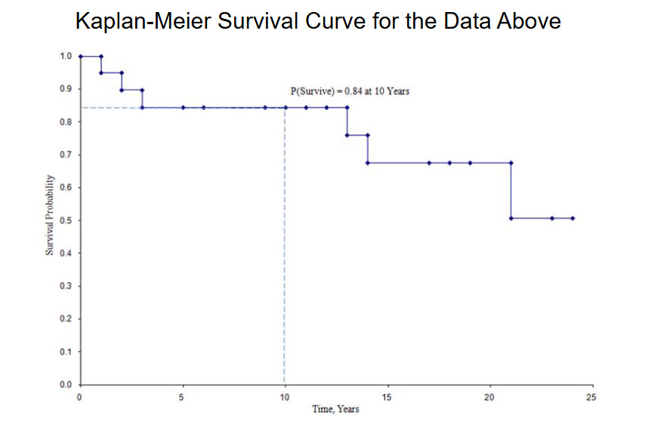
The Survival Function – Kaplan-Meier Method

Slide 36
Survival Functions – Comparing Functions

Slide 37
Survival Functions – Comparing Functions
Could compare median survival time, or probability of surviving up to any particular time.
Better to use a test which compares survivor functions over whole follow-up period.
Two hypothesis tests used to compare two groups are the Log-Rank Test and the Generalised Wilcoxon Test.
Log rank test: tests null hypothesis of no difference between samples in probability of an event (death in this example) at any time point during follow-up.

Slide 38
Survival Functions – Comparing Functions
H₀: survival distributions are equal at all follow-up times.
There is no difference in the survival experience of the groups.
𝐻0:𝑆₁(𝑡)=𝑆₂(𝑡) for all 𝑡
HA: the two survival curves differ at one or more points in time.
There is a difference in survival between the groups.
𝐻𝑎:𝑆₁(𝑡)≠𝑆₂(𝑡)for at least one 𝑡

Slide 39
Survival Functions – Comparing Functions
Log rank test statistic:
At each event time, it compares:
Observed events in each group vs Expected events if survival were the same
Then it sums these differences across all event times.
The test statistic follows a chi‑square distribution with:
Degrees of freedom (df) = number of groups − 1
Assumptions
Two or more independent groups
Censoring independent of future risk (non-informative censoring)

Slide 40
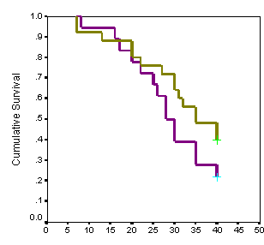
Log rank test
Unlikely to detect a difference between Groups if survivor functions cross over during follow-up.
Assumes non-informative censoring
Can be extended to compare more than 2 groups.
But
Only provides a p-value, not an estimate of size of difference between groups or a confidence interval.
Estimate of size of difference = Hazard Ratio

Slide 41
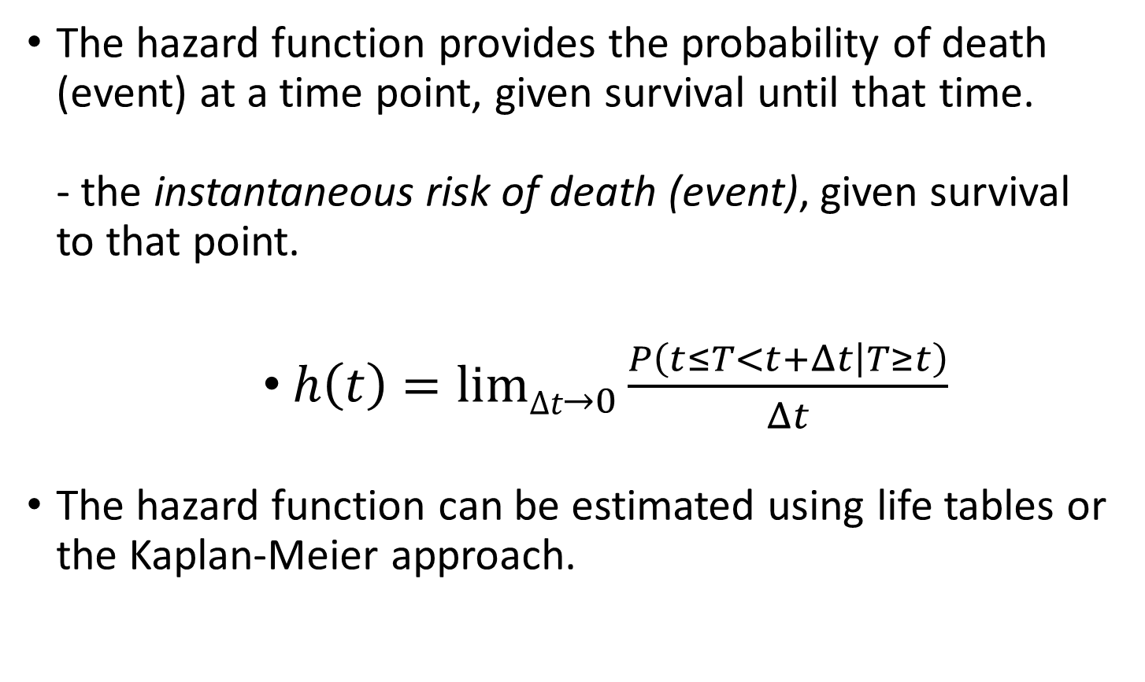
The Hazard Function
The hazard function provides the probability of death (event) at a time point, given survival until that time. - the instantaneous risk of death (event), given survival to that point.
$h\left(t\right)=limΔt_{→0}\frac{P\left(t≤T<\left.t+Δt\right|T≥t\right)}{Δt}$
The hazard function can be estimated using life tables or the Kaplan-Meier approach.

Slide 42
Types of Hazard Functions
The shape of a hazard function reveals crucial information about the process:
Constant Hazard: Exhibited by exponential distributions, where risk remains uniform over time. Example: Radioactive decay.
Increasing Hazard: Observed in ageing systems where risk grows over time. Example: Mechanical wear and tear.
Decreasing Hazard: Seen in populations where risk diminishes as time progresses. Example: Infant mortality.
Non-Monotonic Hazard: Characterised by early failures followed by stable and increasing risk (e.g., the "bathtub curve").

Slide 43
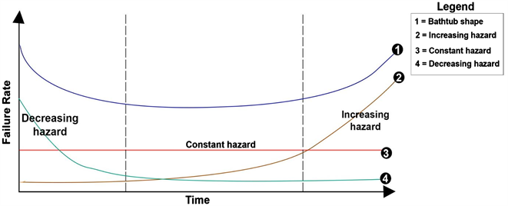
THE HAZARD FUNCTION

Slide 44
THE HAZARD FUNCTION

Slide 46
Comparing Hazard Functions
Hazard functions can be formally compared using regression models - adjustment for potential confounders can also be made. A commonly used model is Cox’s Proportional Hazards Model.
This model is based upon the assumption that the ratio of hazard rates is constant over time
E.g. if the ratio in hazards is 2.0 then, at any given time point, those in the control group are twice as likely to die (relapse in 6-MP) than the intervention.

Slide 47
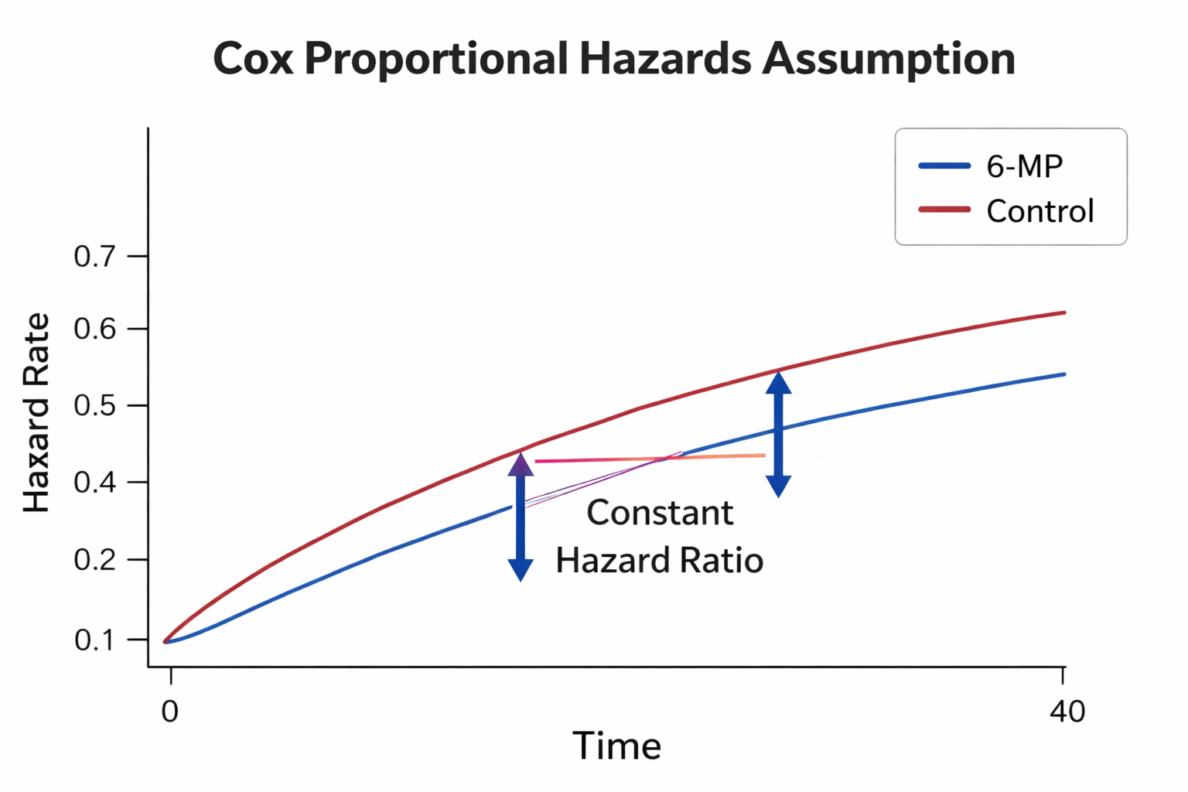
The Hazard Function – Proportional Hazards
The assumption would be violated if:
The curves cross
The gap widens or narrows over time
One curve bends sharply while the other stays flat

Slide 48
Cox Proportional Hazard Model
With the Cox model, we model the impact of different factors 𝑋₁,𝑋₂,…,𝑋_{𝑞} on survival via their impact on the hazard function:
h(t|X)=h₀(t)exp(β₁X₁+β₂X₂+⋯+β_{q}X_{q}),
where:
h(t|X) = hazard at time 𝑡 for a person with covariates 𝑋
h₀(t) = the population-level baseline hazard – the underlying hazard function.
𝑒𝑥𝑝(𝛽₁𝑋₁+𝛽₂𝑋₂+⋯+𝛽_{𝑞}𝑋_{𝑞}) describes how covariates affect the hazard.
In particular, a unit increase in 𝑥𝑖 leads to an increase of the hazard by a factor of exp⁡(𝛽𝑖)

Slide 49
Cox Proportional Hazard Model
Suppose the covariate (risk factor) is dichotomous and is coded 1 if present and 0 if absent. Then the quantity exp(b_{i}) can be interpreted as the instantaneous relative risk of an event, at any time, for an individual with the risk factor present compared with an individual with the risk factor absent, given both individuals are the same on all other covariates.
Suppose the covariate is continuous, then the quantity exp(b_{i}) is the instantaneous relative risk of an event, at any time, for an individual with an increase of 1 in the value of the covariate compared with another individual, given both individuals are the same on all other covariates.

Slide 50
Cox Proportional Hazard Model
If 𝛽=0.5:
𝐻𝑅=𝑒^{0.5}=1.65
Interpretation:
Individuals with 𝑋=1 have a 65% higher hazard of the event at any time compared to those with 𝑋=0.
If 𝛽=−0.7:
𝐻𝑅=𝑒^{−0.7} =0.50
Interpretation:
The hazard is 50% lower (protective effect).

Slide 51
Cox Proportional Hazard Model
You’re studying time to death among adults starting treatment for advanced HIV.
Outcome: time (in months) from ART initiation to death
Censoring: patients lost to follow‑up or alive at end of study
Main exposure:
Regimen=1: Tenofovir‑based ART
Regimen=0: Zidovudine‑based ART (reference)
Covariates: age, sex, baseline CD4 count

Slide 52
Cox Proportional Hazard Model
Fitting the cox proportional hazards model:
ℎ(𝑡∣𝑋)=ℎ₀(𝑡) exp⁡(𝛽₁Regimen+𝛽₂Age+𝛽₃Male+𝛽₄CD4)
Regimen (TDF vs AZT): HR = 0.70
Age (per 10 years): HR = 1.20
Sex (Male vs female): HR = 1.10
CD4 (per 50 cells/µL): HR = 0.85

Slide 53
Cox Proportional Hazard Model
Regimen (HR = 0.70): At any given month after ART initiation, patients on TDF‑based ART have a 30% lower hazard of death than those on AZT, adjusting for age, sex, and CD4.
Age (HR = 1.20 per 10 years): Each additional 10 years of age is associated with a 20% higher hazard of death, holding other variables constant.
CD4 (HR = 0.85 per 50 cells): For every 50‑cell increase in baseline CD4, the hazard of death decreases by 15%.
Male (HR = 1.10, CI includes 1): Slightly higher hazard in men, but not statistically significant.

Slide 54
The Hazard Function – Proportional Hazards
Example Control versus 6-MP
Effect Hazard Ratio 95% C.I.
P-value Group 4.323 (1.99, 9.39) p=0.0002
The estimated risk of relapse is 4.3 times greater in the control group compared to 6-MP at any given time point. i.e. the relative risk is 4.3. Statistically significant from 1.0 (p=0.0002) and potentially a very large effect.
It could be as low as 1.99 to as high as 9.39 with probability 0.95 from the population where the sample came from
After adjusting for age :
Adjusted Effect Hazard Ratio 95% C.I. P-value Group 3.445 (1.59, 7.46) p=0.018

Slide 55
The Hazard Function – Proportional Hazards
The proportional hazards assumption is often violated; when that happens, there are alternative methods that can be used in survival analysis
Stratified Proportional Hazards Models
Use of parametric tests, such as the exponential distribution

Slide 56
Summary of today’s lecture
Survival analysis (time to an event data)
Difficulties involved in analysing such data
Skewed data, usually right skewed
Censoring (left or right)
Methods available to deal with such data
Life Table approach
Kaplan Meier
Cox Proportional Hazard model
Make sure the proportional hazard assumption are justified
Cox model is very good for adjusting for confounders
Other methods includes Weibull model and Exponential model

Slide 57
Summary of today’s lecture, cont
Tests of two survival groups
Log-rank test and Generalised Wilcoxon test
Null hypothesis: Two population survival are the same
Cox Model gives a better test of two or more explanatory variables
It can also quantify the effect with respect to HR
And also adjusting for confounders.
To do survival analysis, given that it is time to an event
One has to have the start date and end date
To work out the outcome of interest
D. Collet, (1994). Modelling survival data in medical research. Chapman & Hall. London.

Slide 58
Survival analysis, the theory
The slides on survival analysis left out a lot of theory which we now present but much of the theory below can be skipped without loss in understanding.
The survival time T may be regarded as a random variable with a probability distribution F(t) and probability density function f(t).
An obvious quantity of interest is the probability of surviving to time t or beyond, the survival function or survival curve S(t), which is given by
A further function which is of interest for survival data is the hazard function.
This represents the instantaneous failure rate, that is, the probability that an individual experiences the event of interest at a time point given that the event has not occurred.

Slide 59
Survival analysis, the theory
It can be shown that the hazard function is given by
Which is the instantaneous risk of failure at time t divided by the probability of surviving up to time t.
Note that the hazard function is just the incidence rate
It follows from equations [1] and [2] that
Where is the integrated hazard function, also known as the cumulative hazard function.

Slide 60
Survival analysis, the theory
Kaplan-Meier estimator
The Kaplan-Meier estimator is a nonparametric estimator of the survivor function S(t).
If all the failure times, or times at which the event occurs in a sample, are ordered and labelled such that , the estimator is given by
Where is the number of individuals who experience the event at time and is the number of individuals who have not yet experienced the event at that time and are therefore still at risk of experiencing it (including those censored at . The product is all failure times less than or equal to t.

Slide 61
Survival analysis, the theory
Cox Regression
We can compare survival in different subgroups by plotting the Kaplan-Meier estimators of the group-specific survivor functions and applying sample significance tests (such as the log-rank test).
However. When there are several explanatory variables, in particular when some of these are continuous, it is much more useful to use a regression method such as Cox regression. Here the hazard function for individuals i modelled as
Where is the baseline hazard function, are regression coefficients

Slide 62
Survival analysis, the theory
And covariates.
The baseline hazard is the hazard when all covariates are zero, and this quantity is left unspecified
This nonparametric treatment of the baseline hazard combined with a parametric representation of the effects of covariates gives rise to the term semiparametric model.
The main assumption of the model is that the hazard of any individual i is a time constant multiple of the hazard function of any individual j,
The factor being
The hazard ratio or incident rate ratio.

Slide 63
Survival analysis, the theory
This property is called the proportional hazard assumption
The exponentiated regression can therefore be interpreted as hazard ratios when the corresponding explanatory variable increases by one unit if all other covariates remain constant.
Integrating the hazard function the hazard function gives the cumulative hazard function
Where is the integral of The survival curve may be obtained from
using equation [3].
This leads to Kaplan-Meier estimator when there are no covariates.

Slide 64
Survival analysis, the theory
It follows from equation [3] that the survival curve for a Cox model is given by
The log of the cumulative hazard function predicted by the Cox model is given by:
So the log cumulative hazard functions of any two subjects i and j are parallel with constant difference given by
Stratified Cox regression can be used to relax the assumption of proportional hazards for a categorical predictor.

Slide 65
Practical exercise
In this exercise, we are going to analyse data on heroin addicts in two different clinics receiving methadone maintenance treatment to help overcome their addiction.
Early dropout is an important problem with this treatment. We will therefore analyse the time from admission to termination of treatment (in days), given as the variable “time” in the data set.
For patients still in treatment when these data were collected, their time is the time from admission to the time of data collection.
The variable “status” is an indicator for whether “time” refers to drop out (1) an event of interest, or end of study (0), hence censored, event not observed.
Possible explanatory variables for retention in treatment are:

Slide 66
Practical exercise
Maximum methadone dose and a prison record (1=yes, 0=no) as well as which of the two clinics the addict was treated in.
These variables are called “dose”, “prison”, and “clinic”, respectively. Open the data heroin.dta depending on your version of stata.
These data were first analysed by Calplehorn and Bell (1991) and also appear in Hand et al. (1994).
The data can be described as survival data, although the ‘end point’ is not death in this case, but drop out from treatment.
Sometimes the end point (or event) in survival data is referred to as failure.

Slide 67
Practical exercise
Before fitting any model in stata, we need to declare the data as being of the survival form by using “st” (standing for survival time) using the “stset” command
stset time, failure(status)
Looking at the summary data after declaring in stata, we use the command:
stsum
There are 238 subjects with a median survival time of 504 days. The lower quartile survival time was 212 days and upper quartile time is 821 days.
Total person time at risk is 95812 days.

Slide 68
Practical exercise
If the incident rate (i.e. hazard function) could be assumed to constant, it would be estimated as 0.0016 per day or 1.6 per 1000 persons per day, which would correspond to 0.0015656*365.25=0.57 per year or 570 per 1000 persons per year .
stsum
failure _d: status
analysis time _t: time
| incidence no. of |------ Survival time -----|
| time at risk rate subjects 25% 50% 75%
---------+---------------------------------------------------------------------
total | 95812 .0015656 238 212 504 821

Slide 69
Practical exercise
The lower quartile of survival time—also known as the 25th percentile—is the time by which 25% of the study population has experienced the event (e.g., death, relapse, failure), and 75% are still surviving.
The upper quartile of survival time—also called the 75th percentile—is the time by which 75% of the study population has experienced the event, and 25% remain event-free.
Median survival time is the point at which 50% of the study population has experienced the event (e.g., death, relapse, failure), and 50% are still event-free. It’s a central summary measure in survival analysis, especially when the data are skewed or censored.

Slide 70
Practical exercise
Overall survival using Life-table approach with 30 days interval

Slide 71
Practical exercise
Life table survival curves for different prisons

Slide 72
Practical exercise
Life table survival curves for different clinics

Slide 73
Practical exercise
Summary values
stci
failure _d: status
analysis time _t: time
| no. of
| subjects 50% Std. Err. [95% Conf. Interval]
-------------+-------------------------------------------------------------
total | 238 504 33.24933 394 550
stci, by(prison)
failure _d: status
analysis time _t: time
| no. of
prison | subjects 50% Std. Err. [95% Conf. Interval]
-------------+-------------------------------------------------------------
0 | 127 523 39.21973 452 612
1 | 111 394 76.79186 262 550
-------------+-------------------------------------------------------------
total | 238 504 33.24933 394 550

Slide 74
Practical exercise
Different clinics
stci, by(clinic)
failure _d: status
analysis time _t: time
| no. of
clinic | subjects 50% Std. Err. [95% Conf. Interval]
-------------+-------------------------------------------------------------
1 | 163 428 48.58948 341 512
2 | 75 . . 661 .
-------------+-------------------------------------------------------------
total | 238 504 33.24933 394 550

Slide 75
Practical exercise
Kaplan-Meier for different prisons

Slide 76
Practical exercise
Kaplan-Meier for different clinics

Slide 77
Practical exercise Log-rank test, prisons
sts test prison
failure _d: status
analysis time _t: time
Log-rank test for equality of survivor functions
| Events Events
prison | observed expected
-------+-------------------------
0 | 81 87.75
1 | 69 62.25
-------+-------------------------
Total | 150 150.00
chi2(1) = 1.26
Pr>chi2 = 0.2617

Slide 78
Practical exercise Wilcoxon test, prisons
sts test prison, wilcoxon
failure _d: status
analysis time _t: time
Wilcoxon (Breslow) test for equality of survivor functions
| Events Events Sum of
prison | observed expected ranks
-------+--------------------------------------
0 | 81 87.75 -1434
1 | 69 62.25 1434
-------+--------------------------------------
Total | 150 150.00 0
chi2(1) = 2.56
Pr>chi2 = 0.1096

Slide 79
Practical exercise Log-rank test, clinics
sts test clinic
failure _d: status
analysis time _t: time
Log-rank test for equality of survivor functions
| Events Events
clinic | observed expected
-------+-------------------------
1 | 122 90.91
2 | 28 59.09
-------+-------------------------
Total | 150 150.00
chi2(1) = 27.89
Pr>chi2 = 0.0000
Results show a difference in the survival functions of the two clinics at one or more time points

Slide 80
Practical exercise Wilcoxon-rank test, clinics
sts test clinic, wilcoxon
failure _d: status
analysis time _t: time
Wilcoxon (Breslow) test for equality of survivor functions
| Events Events Sum of
clinic | observed expected ranks
-------+--------------------------------------
1 | 122 90.91 2929
2 | 28 59.09 -2929
-------+--------------------------------------
Total | 150 150.00 0
chi2(1) = 11.63
Pr>chi2 = 0.0007

Slide 81
Fitting a Cox model
xi: stcox dose prison i.clinic
i.clinic _Iclinic_1-2 (naturally coded; _Iclinic_1 omitted)
failure _d: status
analysis time _t: time
Cox regression -- Breslow method for ties
No. of subjects = 238 Number of obs = 238
No. of failures = 150
Time at risk = 95812
LR chi2(3) = 64.52
Log likelihood = -673.40242 Prob > chi2 = 0.0000
------------------------------------------------------------------------------
_t | Haz. Ratio Std. Err. z P>|z| [95% Conf. Interval]
-------------+----------------------------------------------------------------
dose | .965223 .0061576 -5.55 0.000 .9532294 .9773675
prison | 1.386123 .231789 1.95 0.051 .9987642 1.923715
_Iclinic_2 | .3646309 .0783486 -4.70 0.000 .2393068 .5555868
------------------------------------------------------------------------------
A unit increase in the methadone dose reduces the hazard of dropping out treatment by 3.8%
Having a prison record increased the hazard of dropping out of treatment by 39%

Slide 82
Checking proportion assumptions of Cox-Model

Slide 83
Checking proportion assumptions of Cox-Model

Slide 84
Fitting the Cox-Model relaxing the proportional assumptions in clinics
. stcox dose prison, strata(clinic)
failure _d: status
analysis time _t: time
Stratified Cox regr. -- Breslow method for ties
No. of subjects = 238 Number of obs = 238
No. of failures = 150
Time at risk = 95812
LR chi2(2) = 33.94
Log likelihood = -597.714 Prob > chi2 = 0.0000
------------------------------------------------------------------------------
_t | Haz. Ratio Std. Err. z P>|z| [95% Conf. Interval]
-------------+----------------------------------------------------------------
dose | .9654655 .0062418 -5.44 0.000 .953309 .977777
prison | 1.475192 .2491827 2.30 0.021 1.059418 2.054138
------------------------------------------------------------------------------
Stratified by clinic

Slide 85
Fitting the Cox-Model relaxing the proportional assumptions in prisons
i: stcox dose i.clinic, strata(prison)
i.clinic _Iclinic_1-2 (naturally coded; _Iclinic_1 omitted)
failure _d: status
analysis time _t: time
Stratified Cox regr. -- Breslow method for ties
No. of subjects = 238 Number of obs = 238
No. of failures = 150
Time at risk = 95812
LR chi2(2) = 60.05
Log likelihood = -572.7156 Prob > chi2 = 0.0000
------------------------------------------------------------------------------
_t | Haz. Ratio Std. Err. z P>|z| [95% Conf. Interval]
-------------+----------------------------------------------------------------
dose | .9655677 .0061875 -5.47 0.000 .9535163 .9777714
_Iclinic_2 | .3845853 .083558 -4.40 0.000 .2512199 .5887507
------------------------------------------------------------------------------
Stratified by prison

Slide 86
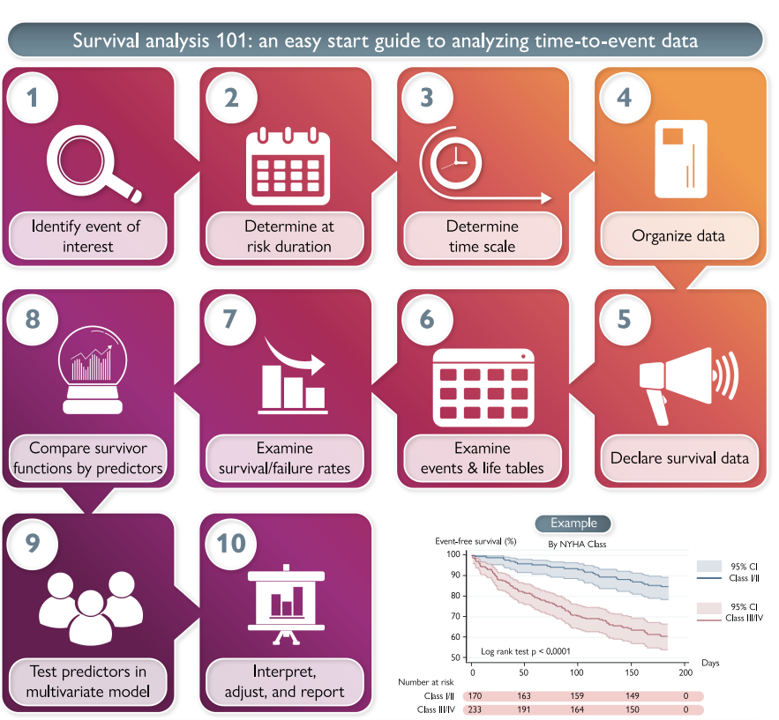
Steps to analysing time to event data

Slide 87
Example Paper
The event of interest was time to first cardiovascular event, a composite outcome that included all-cause death or cardiovascular hospitalization or emergency department visit.
The duration a participant was at risk for the event was 6 months.
Event data were recorded in days
The sample included 403 participants (59% male; mean age 58.7 ± 14.4 years).
The majority of participants (58%) were NYHA Class III/IV.

Slide 88
Example
NYHA is the ‘New York Heart Association (NYHA) functional classification’
The Charlson Comorbidity Index was categorized as low [1–2 comorbidities (58%)], medium [3– 4 comorbidities (33%)], and high [5 and more comorbidities (9%)].
A total of 118 cardiovascular events (29%) were reported, which included 10 deaths, 82 cardiovascular hospitalizations, and 26 cardiovascular emergency department visits.
Each participant entered the study period at time zero, and median exit time was 149.4 days (range = 1–185 days)

Slide 89
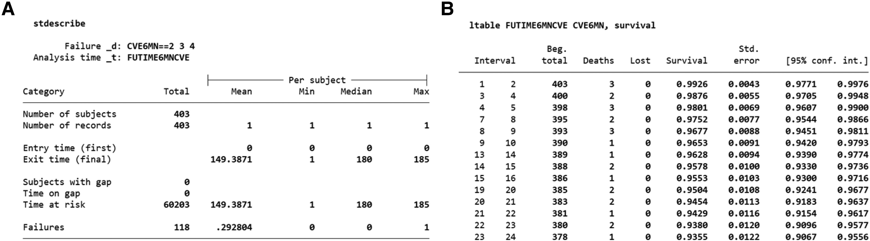

Slide 90
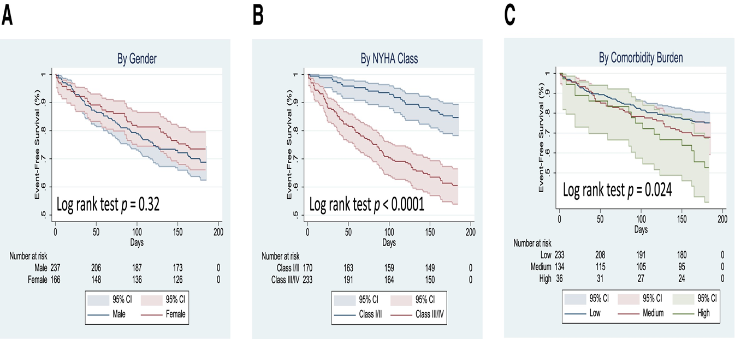
Presenting results

Slide 91
Interpreting Survival analysis results
The hazard ratios are interpreted in terms of a one unit change in the value of the variable, which is similar to interpreting odds ratios or risk ratios.
For example, a hazard ratio of 1.5 would be interpreted as a 50% greater risk in the event happening within the specified time frame (assuming significance).
Precision around hazard ratios should be reported as 95% confidence intervals.

Slide 92
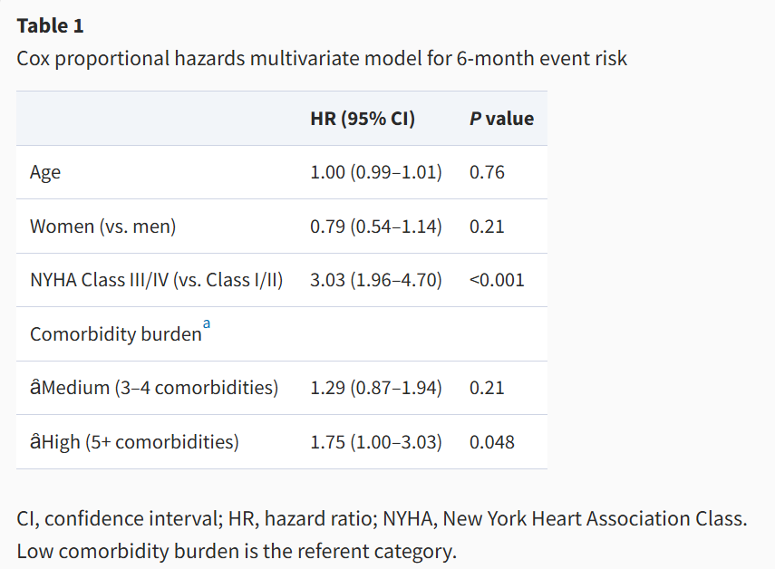
Cox Proportional Hazards Results

Slide 93
Cox Proportional Hazards Results
After including all four variables in an adjusted multivariable regression model, NYHA classification and comorbidity burden were significant, but age and gender were not
Specifically, those with NYHA Class III/IV were about two times more likely to experience an event than those with NYHA Class I/II
Those with high comorbidity burden were about 75% more likely to experience an event than those with low comorbidity burden.

Slide 94
References and Acknowledgement
Hosmer, DW and Lemeshow, S. Applied Survival Analysis: Regression Modeling of Time to Event Data. NewYork: John Wiley and Sons; 1999.
Cox DR, Oakes D. Analysis of Survival Data, Chapman and Hall, 1984.
Lee ET and Wang JW. Statistical Methods for Survival Data Analysis. 3rd edition. New York: John Wiley & Sons; 2003.
Adapted from slides by Prof Musonda

